Slide 1
What is Software Engineering?

Slide 2
Comparison
Computer Science
Computer science takes a broad approach to the study of the principles and use of computers that covers both theory and application. This field involves the understanding and application of both abstract and concrete knowledge.
Software Engineering
Software engineering is a field largely concerned with the application of engineering processes for the creation, maintenance, and design of software for a variety of different purposes.
Notes:
Resource: https://www.onlineengineeringprograms.com/faq/cs-vs-software-engineering

Slide 3
What does a software engineer do?

Slide 4

Creates Software Plans & Diagrams
Notes:
https://www.brookes.ac.uk/courses/postgraduate/software-engineering/

Slide 5

Communicates with Large Groups
Notes:
https://medium.com/s/story/youre-working-in-the-wrong-place-e289036ee01c

Slide 6

Builds New Software
Notes:
http://www.consultingspace.com.au/business-strategic-planning-setting-up-your-off-site-planning-session-for-success-2/

Slide 7

Enhances Existing Software
Notes:
https://www.123rf.com/photo_108568704_the-abstract-image-of-the-skyscraper-image-overlay-with-business-chart-and-binary-code-image-the-con.html

Slide 8

Prevents Software/Code Decay
Notes:
https://www.wired.com/2016/08/experts-answer-biggest-questions-earthquakes/

Slide 9
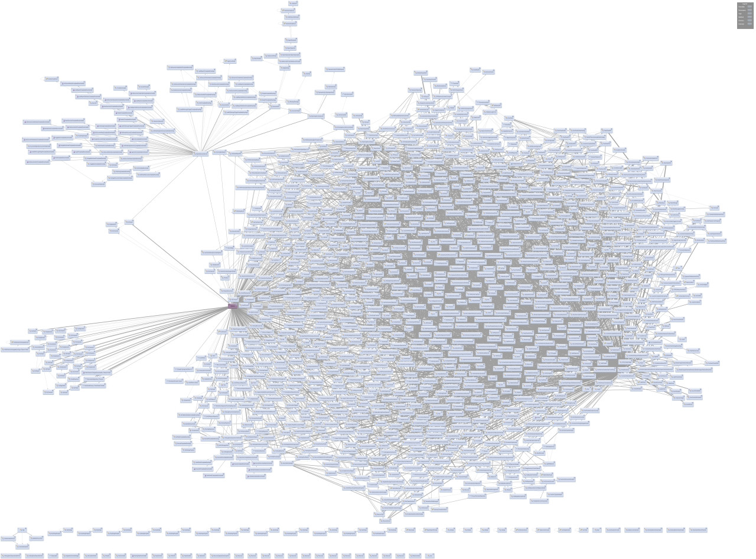
Often Works on Huge Code Bases
Notes:
https://softwareengineering.stackexchange.com/questions/225860/what-is-the-norm-for-introducing-new-hires-to-a-code-base

Slide 10

Determines How to Construct Large Complex Software from Smaller Pieces

Slide 11
What are the different roles in software engineering?

Slide 12

Programmer/
Software Engineer
Implements the design from the Software Architect.
Makes the low level choices, decides what algorithms and logic to use.
The project builders.
Beginners to leading experts in programming.
There are multiple levels of software engineers based on experience
Top experts in programming are often called Principal Engineers
Notes:
https://www.networkcomputing.com/data-centers/12-hot-programming-languages-infrastructure-pros

Slide 13

Quality Assurance
(QA) Engineer
Makes sure that the system meets the requirements.
Makes sure that every part of the system has been tested thoroughly.
Beginners to leading experts in testing.
Notes:
https://www.lynda.com/Developer-Programming-Foundations-tutorials/Foundations-Programming-Software-Quality-Assurance/126119-2.html

Slide 14

UI/UX Designer
Designs what the user will see (User Interface).
Responsible for how the user feels while interacting with the site (User eXperience).
Ensures a product makes sense to the user.
UI/UX are just as important as the functionality.
Notes:
https://www.youtube.com/watch?v=60zhX909jmQ (only for the image)

Slide 15

Software Architect
Creates elegant, flexible, and durable designs
Makes high-level design choices
Dictates technical standards, tools, and platforms
The leading technical experts
Often there are multiple levels of architect
Architect, Senior Architect, Principal Architect
Notes:
http://stcorp.nl/highlights/software-architecture-consulting/
https://en.wikipedia.org/wiki/Software_architect (2019)

Slide 16

Manager
Responsible for managing people on a software team.
Meets regularly with team members.
Makes hiring/firing decisions (in consultation with upper management--Directors, VP’s and CTO).
Creates the schedule.
Enforces deadlines.
Notes:
http://www.businessrole.net/management/management-is-drawback-fixing.html

Slide 17

Software Engineering Director
Directs and oversees the developing, releasing, and maintaining of software applications.
Establishes policies and procedures that produce high-quality software products and services.
Manages the managers.
Typically reports to top management.
Notes:
https://www.masterfile.com/search/en/director+chair
https://swz.salary.com/salarywizard/Software-Engineering-Director-Job-Description.aspx

Slide 18

VP of Technology
Personnel management - direct supervisor of the technical staff.
Often manages contributing engineering managers, who serve as the direct supervisor of the technical staff.
Responsible for ensuring that the product vision is realized through excellence in execution.
Reports to the CTO.
Responsible for co-developing the technical strategy with the CTO.
Notes:
https://www.ivyexec.com/career-advice/2015/cto-versus-vp-engineering-whats-the-difference/
http://smarterware.org/2016/09/5-reasons-midst-technological-golden-age/ (Picture)

Slide 19

Chief Technology Officer (CTO)
The highest ranking technical person in a company.
Presides over the overarching technology infrastructure.
Monitors technological, social and scientific trends that could influence the company's business goals.
Identify opportunities and risks for the business.
Responsible for the entire technical budget.
An executive who reports to the company CEO or President.
Notes:
https://www.information-age.com/path-becoming-chief-technology-officer-123464532/
https://searchcio.techtarget.com/definition/Chief-Technology-Officer-CTO

Slide 20
How much do software engineers get paid?

Slide 21
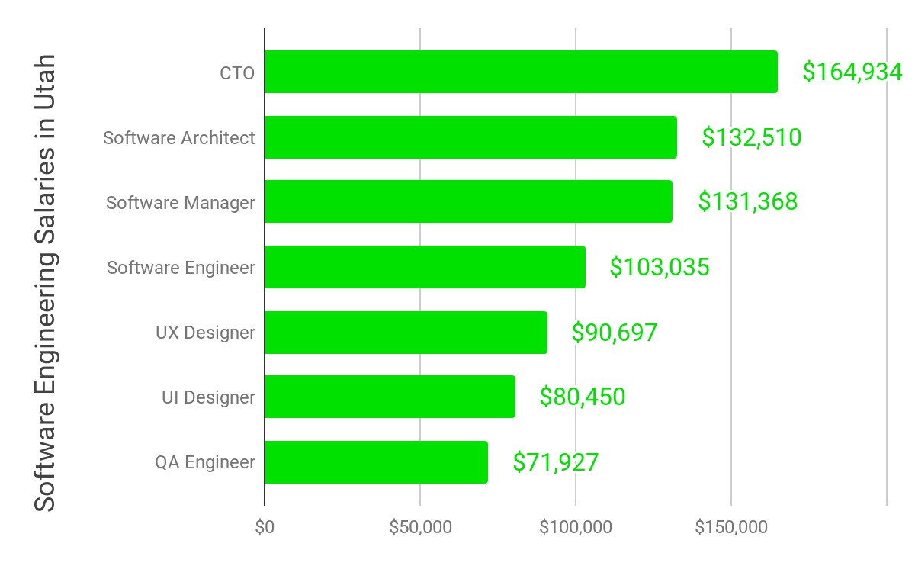
Notes:
https://docs.google.com/spreadsheets/d/1zmsNTNLVK2nYDc-V6wVttbY8mGt_cdjpKZwuIFuwQnM/edit?usp=sharing (Link to Information if you need to change it)

Slide 22
Do software engineers like their jobs?

Slide 23

Software Developer is the #1 US Job
Top Rated Job by US News and World Report in their 2019 Job Rankings
#1 in 100 Best Jobs List
#1 in Best Stem Jobs
#1 in Best Technology Jobs
Notes:
https://www.lynda.com/Developer-Programming-Foundations-tutorials/Foundations-Programming-Software-Quality-Assurance/126119-2.html

Slide 24
Questions?

